Slide 1

IMAGE FORGERY DETECTION AND CLASSIFICATION
Phase 1- Review 2
Group No : 31
GUIDE: Dr. Aarthi R
NAME | ROLL NUMBER
CHERUVU SAHITHEE VAIBHAV | CB.EN.U4CSE21414
KHAJI MAHAMMAD SAMI | CB.EN.U4CSE21430
NADIMPALLI UJWAL SRIMANTH VARMA | CB.EN.U4CSE21440
VINAYAKAN V S | CB.EN.U4CSE21467

Slide 2
Guide’s Approval Mail

Slide 3
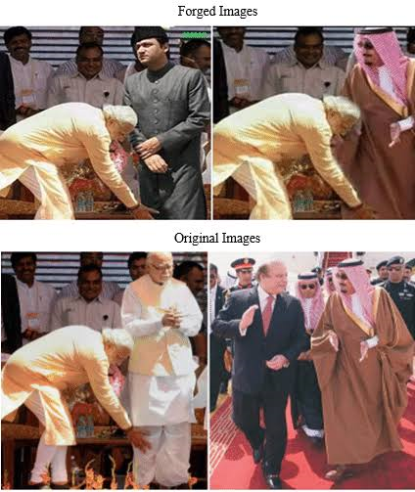
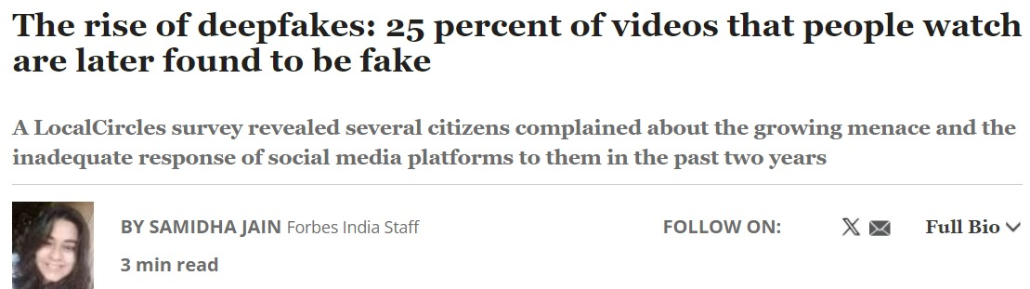
Introduction
Sophisticated Techniques: Advanced AI tools make forgery detection increasingly difficult.
Critical Impact Areas:
Criminal Evidence: Tampered images can mislead investigations.
Insurance & Journalism: Fabricated visuals affect claims and public trust in media.
Survey Data: 30% of respondents report 1 in 4 videos viewed is fake (LocalCircles).
Consequences:
Politics: Misinformation sways elections and fuels public manipulation.
Social Harm: Deepfakes and false visuals spread gender-based violence and hate speech.

Slide 4
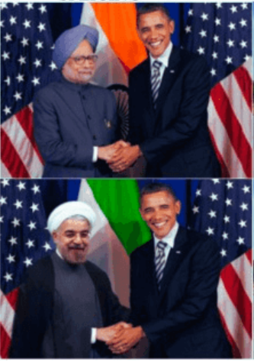
Motivation
Social Media
Deepfakes: Over 49,000 deepfake videos online (2020).
Misinformation: Key driver of false news on platforms like Facebook and Twitter.
Politics
Election Interference: 70% of people saw manipulated political content (2020).
Trust Erosion: 68% worry about deepfakes harming trust in media.
Crime
Financial Fraud: A CEO lost $243,000 to a deepfake call.
Identity Theft: 300% rise in deepfake scams (2020-2022).
Entertainment
Piracy: AI deepfakes cost millions in copyright violations.
Celebrity Abuse: 1,000+ celebrities targeted by fake content.
Emotional Impact
Harassment: 1 in 10 women affected by deepfake pornography.
Trust Issues: 58% question online content's authenticity.
Authentic

Slide 5
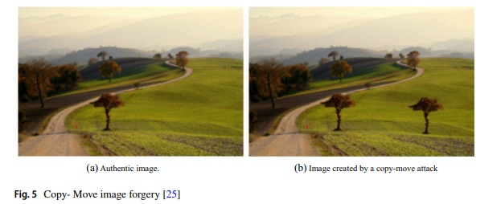
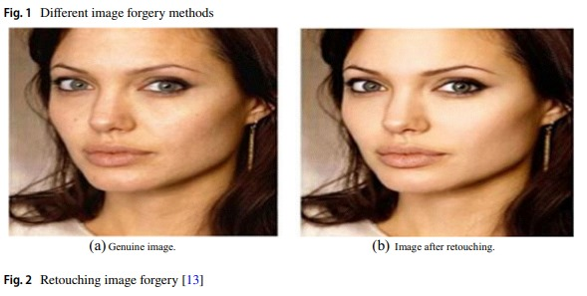
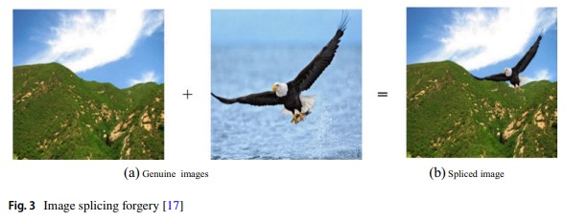
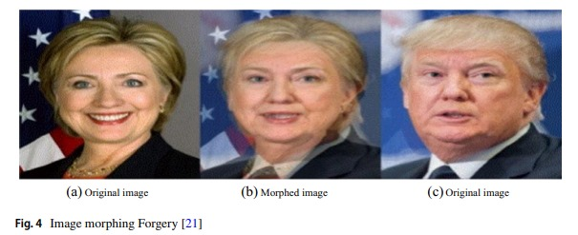
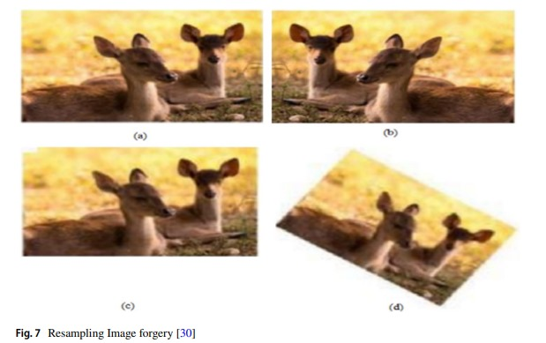
Image Forgery Techniques
Image Retouching
Image Splicing
Image Morphing
Resampling Attack
Copy-Move
Rotation
Scaling
Stretching
6

Slide 6
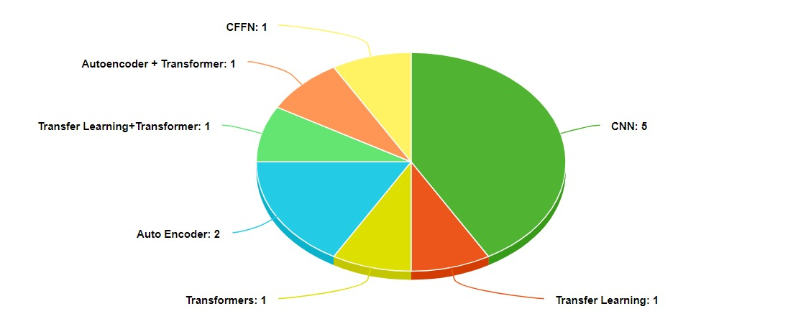
Literature Survey
Models Types

Slide 7
S.No | Title | Purpose | Models used & approaches | Input & Output | Results
[1]. | Fusion Transformer with Object Mask Guidance for Image Forgery Analysis [2024] | To detect and localize image forgeries using object-guided information | OMG-Fuser model: fusion transformer with Object Mask Guidance (OMG),Object-Guided Transformer(OGT), Token Fusion Transformer(TFT),Long-range Dependencies Transformer(LDT) | Input: Images with Forensic signals such as noise patterns and color inconsistencies; Dataset:CASIAv1+,Columbia,Coverage,NIST16,OpenForensics,CocoGlide,DID Output: Forgery detection and localization | Achieving a significant improvement in F1 score upto 20.4% in image localisation compared to state of the art models
[2]. | Unveiling the Truth: Exploring Human Gaze Patterns in Fake Images [2024] | Investigate human gaze patterns for detecting manipulated images | The paper uses eye-tracking experiments to analyze participants' gaze patterns when viewing real and manipulated images. It highlights that human visual attention can reveal consistent patterns, integrating human semantic knowledge to improve fake image detection. | Input: COCO, ADE20K, LHQ datasets; Output: Gaze concentration differences for real vs. fake images | Results show significant differences in gaze concentration, measured through lower entropy values for fake images.
[3]. | ResTran: Long distance relationship on image forgery detection[2023] | Identify tampering in images, particularly splicing and copy-move operations | ResNet for local feature extraction, Transformer encoder for long-range dependencies | Input: NIST16, CASIA, IMD2020 datasets; Output: Image tampering detection | The model achieved high AUC values (of 0.865 , 0.958 and 0.906) on the CASIA , NIST16 and IMD2020 datasets, demonstrating strong generalization. It also showed effective tampering detection, with an F1 score of 0.689 , 0.850 , 0.865 on CASIA , NIST16 , IMD2020.
8

Slide 8
S.No | Title | Purpose | Models used & approaches | Input & Output | Results
[4]. | Image Forgery Detection Using Deep Learning by Recompressing Images[2022] | Detect image tampering by exploiting the differences in compression between tampered and genuine regions. | lightweight CNN model with three convolutional layers and recompresses images to detect tampering by highlighting compression differences between genuine and forged regions. | Input:CASIA 2.0, Input image size:128 x 128. Output:Binary classification indicating whether the image is genuine or not. | The proposed model achieved 92.33% accuracy in detecting image forgery on the CASIO 2.0 dataset.
[5]. | An Efficient Image Forgery Detection Framework using Transfer Learning Models[2024]. | To detect image forgery using transfer learning models. | The method employs transfer learning using pretrained models like ResNet50, VGG16, Xception, Densenet201, MobileNet, and NasNetMobile. | Dataset:220 images of MICC-F220,It has image sizes between 722 x 480,800x 600. Output:the output is a binary classification indicating whether the image is authentic or tampered. | The ResNet50 model achieved 96% accuracy after 15 epochs on the MICC-F220 dataset.
[6]. | Image forgery detection by combining Visual Transformer with Variational Autoencoder Network[2024] | To detect image forgeries by differentiating between authentic and tampered regions. | The ViT–VAE architecture uses a Visual Transformer with self-attention for detecting manipulations, followed by VAE for feature extraction and MLP for generating a mask to differentiate authentic from tampered regions. | The input consists of images from datasets like CASIAv2, IMD2020, COLUMBIA, COVERAGE, and In-the-Wild, with varying image sizes, and the output is a mask identifying non-authentic and authentic parts of the image. | F1-score: Coverage: 0.768, In-the-Wild: 0.752, IMD2020: 0.765, Columbia: 0.842 AUC: Coverage: 0.942, In-the-Wild: 0.923, IMD2020: 0.864, Columbia: 0.942
[7]. | Detection of GAN-manipulated Medical Images through Deep Learning Techniques [2024] | To detect GAN-generated forgeries in medical CT scans | Combines LBP preprocessing, U-Net for segmentation, SVM for classification | Dataset: LIDC-IDRI ,CT-GAN datasets. Ouput: Classify and localize the tampered regions. | 93.9% accuracy, 94% F1-score, and 99.2% ROC AUC.
9

Slide 9
S.No | Title | Purpose | Models used & approaches | Input & Output | Results
[8]. | Prediction model for digital image tampering using customized deep neural network techniques [2024] | This paper aims to identify various types of image tampering [copy_move,inpainting,splicing,normal images] | Uses ResNet50V2,InceptionNetV3,MobileNetV2 and a custom CNN which include an input layer + Initial CNN layers(batch normalization + max-pooling) + Separable Convolution Layer + fully connected layers | Dataset include Defacto + COCO And the model predicts the type of forgery or classify it as normal | The custom model (90%) achieved greater accuracy compared to Inception (71%),ResNet(67%),MobileNet(77%),
[9]. | Deep Fake Image Detection Based on Pairwise Learning [2020] | This paper mainly focuses on identifying images generated by various GAN architectures | Uses DenseNet with a Siamese network structure to allow pairwise input for learning common fake features.[CFFN – Common Fake Feature Network] | Dataset include CelebA, GAN-generated Images[DCGAN,WGAP,WGAN-GP,LSGAN,PGGAN] from CelebA, IRSVRC12 Input is a pair of fake and real images Ouput is a binary classification whether the image is fake or not | Precision of proposed model range from 92-98% for different set of GAN generated images Recall from 75%-98% for different set of GAN generated images
[10]. | Image Splicing Detection using Feature Based on Machine Learning Methods and Deep Learning Mechanisms [2022] | to detect image splicing using various Machine learning and Deep Learning techniques | 1.SVM + Markov features [DCT] 2.Logistic Regression + HOG +DWT +LTE+LBP 3.SVM + SVD+DCT+PCA 4.SVM + QDCT 5.SVM + LBP + DCT 6.Mask-RCNN + ResNet 7.CNN + WPIC 8.ResNet50 9.CNN + CRF | Dataset used : CASIA v1.0,v2.0, Columbia Dataset,DSO-1 and DSI-1,COCO Digital images as input and detects whether an image has been spliced | In ML –>92 - 99.5% In DL – >96-97%
[11]. | What Makes Fake Images Detectable? Understand Properties that Generalize [2020] | This paper aims to identify what properties of fake images that make them identifiable | ResNet-18,MesoInception,Xception with a patch-based learning approach | Output is that the model detects whether the image is fake or real. | with highest resolution for images (1024) , CNN(p=0.5) has 99.83,CNN(p=0.1) has 99.78,Xception has 97.28,ResNet has 80.17,MesoInception has 87%
10

Slide 10
S.No | Title | Purpose | Models used & approaches | Input & Output | Results
[12]. | Fake region identification in an image using deep learning segmentation model [12].2021 | To improve the detection of fake regions in images, particularly focusing on copy-move and spliced forgeries. | Traditional U-NET Model was modified by adding batch normalization and identity blocks which reduces pixel loss and overfitting. Sigmoid is used to authenticate pixels | Input: 2-Datasets containing copy-move and spliced forgery examples. Output: Pixel-level localization of fake regions | proposed model gave an accuracy of 99% in domains containing medical, natural, identity images. but failed classifying scanned documents with accuracy-89%.
[13]. | Detecting image manipulation with ELA-CNN integration: a powerful framework for authenticity verification [13].2024 | For detection of image splicing by Error Level Analysis (ELA) which uses variations in compression levels that indicate tampering. | Uses ELA+CNN Model where steps involves: Compression of image to lossy format, calculating the error level by subtracting the previous image and image is fed into CNN to detect manipulation patterns and classify. | Input: CASIA-2.0 dataset Output: A binary classification indicating whether an image is tampered or authentic, along with marked tampered regions. | Train accuracy is 99.05% and Test accuracy is 94.14% .However, the method is limited to detecting splicing without identifying specific tampering techniques.
[14]. | Image Copy-Move Forgery Detection based on Machine Learning[14].2024 | Identifying copy-move forgeries by analysing regions of an image that have been duplicated and repositioned. | Uses a block-based extraction method with a sliding window technique to compare blocks for identifying matches. This approach facilitates robust detection of copied regions. | Input: DVMM, private dataset Output: localization of forged regions within the images. | They Claim that the approach successfully detect copy-move forgeries but when dealing with uniform areas like the sky it may lead to false positives.
[15]. | A Detailed Analysis of Image and Video Forgery Detection Techniques[15]. 2023 | To provide a survey on of state-of-the-art techniques for detecting both image and video forgeries, along with their strengths and weaknesses in different scenarios. | A thorough survey encompassing traditional machine learning and advanced deep learning techniques, including VAEs, GANs, and both block-based and keypoint-based methods. | Insights on various detection methodologies, along with recommendations for future research by providing information of datasets and efficient models. | Deep learning methods outperform traditional approaches in tampering detection but require large datasets and computational power. Standard benchmarks and diverse datasets are needed for better evaluation across different forgery types.

Slide 11
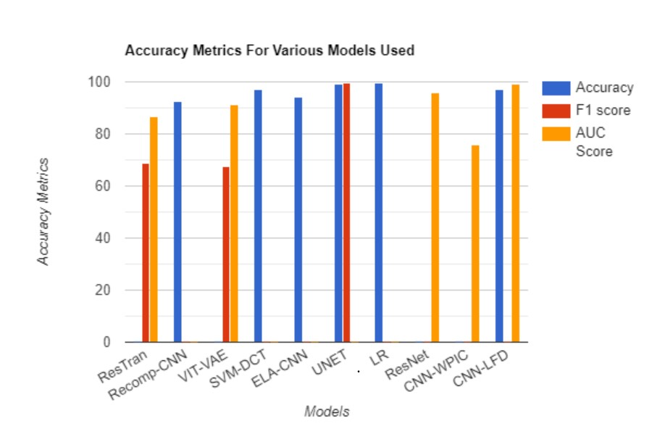
Performance Metrics
12

Slide 12
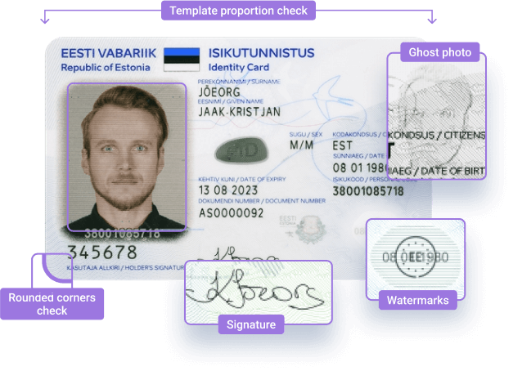
Research Gap
1. Handling Forgery in Scanned Documents and Printed Media
Research on detecting forgeries in digital documents and printed media is limited, and the existing studies often produce unsatisfactory results. These shortcomings can result in serious legal issues and cases of digital fraud, especially in identity recognition.
Objective:-
To pinpoint essential features and parameters in digital documents that assist in detecting forgery
Examples:- Water Marks, Font Consistency
13

Slide 13
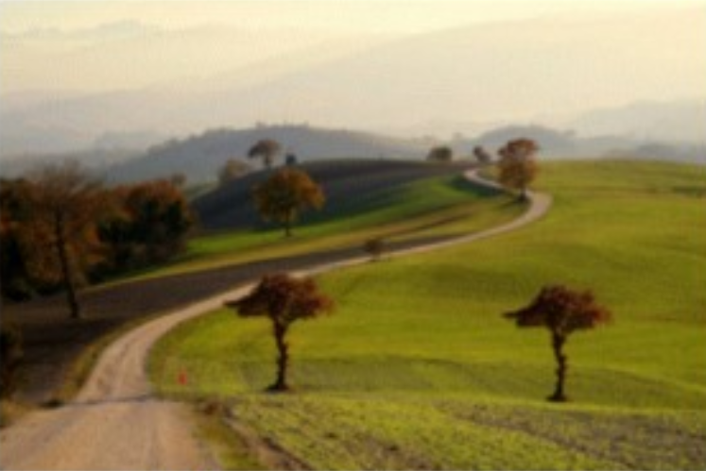
Research Gap
2. Differentiating Between Types of Forgery:
There is a limited research on categorizing the types of forgery such as copy move, image splicing , inpainting etc.
Objective:-
Create a sophisticated deep learning architecture using existing U-NET that accurately classifies different categories of forgeries.
Copy Move
✅
Model
Image splicing
❌
inpainting
❌
14

Slide 14
Problem Statement
To develop a model that accurately localize forgeries in images and documents, with potential expansion based on results using .
Objectives for phase 1:
Dataset Confirmation
Training and evaluating U-Net model
Localising of tampered regions
Objectives for phase 2:
Improving U-Net Model
Including document level analysis
16

Slide 15
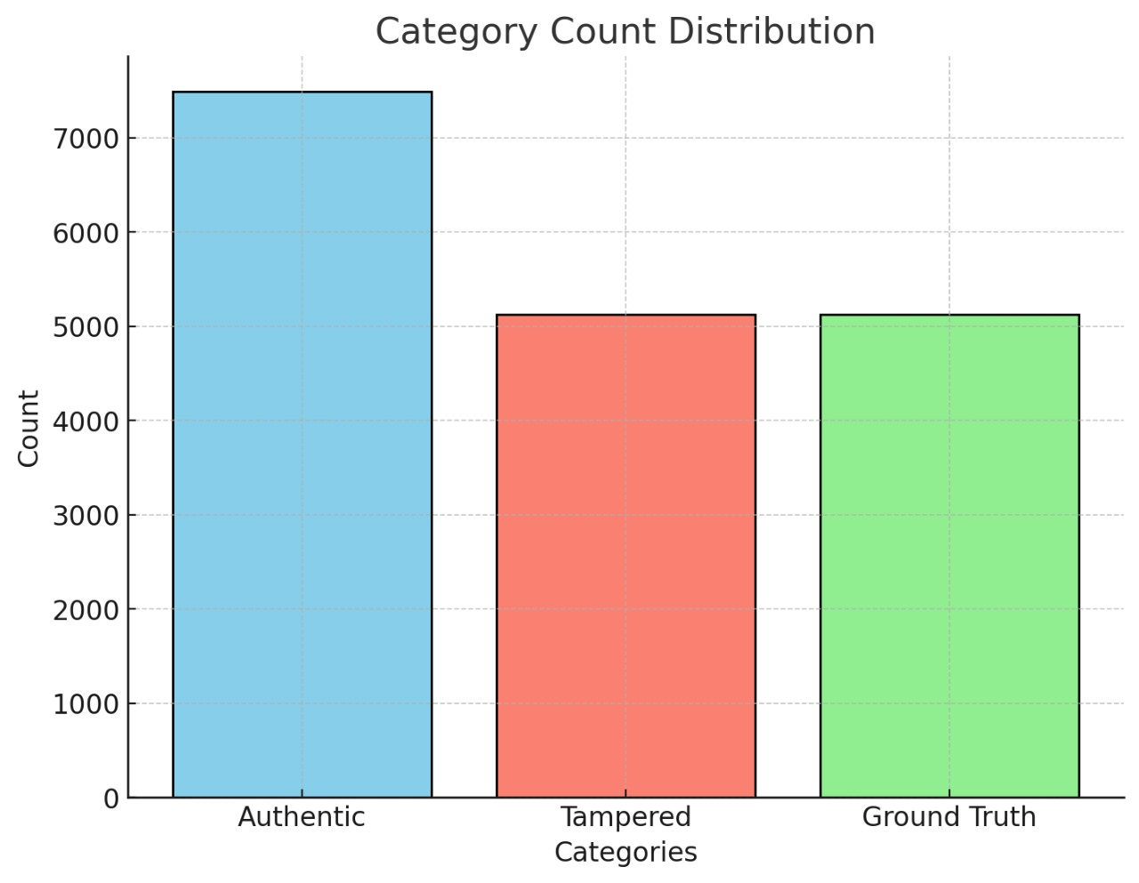
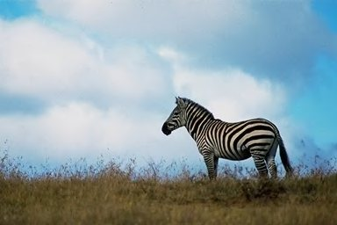


Dataset description
Dataset used: CASIA 2.0
containing
Authentic Images-7491
Tampered -5123
Ground truth Images for authentic Images -5123
Authentic
Tampered
Ground Truth Mask

Slide 16
Dataset statistics
From the given data, we have extracted the metadata which explains about different widths of images
We have found out that the data set has multiple channels ranging from 1 to 4 . This means there are both black-and-white images (1 channel) and color images (3 or 4 channels, with 4 including transparency).

Slide 17
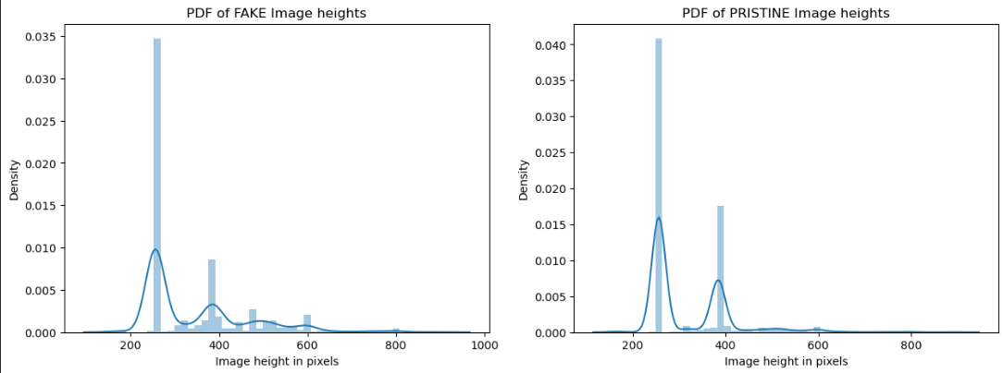
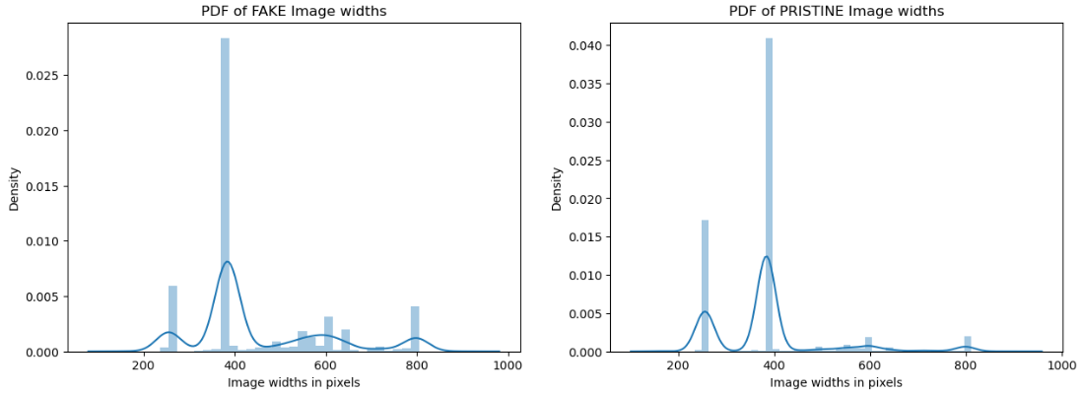
Dataset statistics
We have found out that height and width of an image do not play a key role in classifying image type regarding w.r.t this dataset.

Slide 18



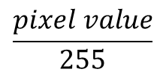
Dataset preprocessing
1
2
Fixed image size 512X512
$$\frac{pixel value}{255}$$
Images of various sizes
Min – Max Scaling

Slide 19
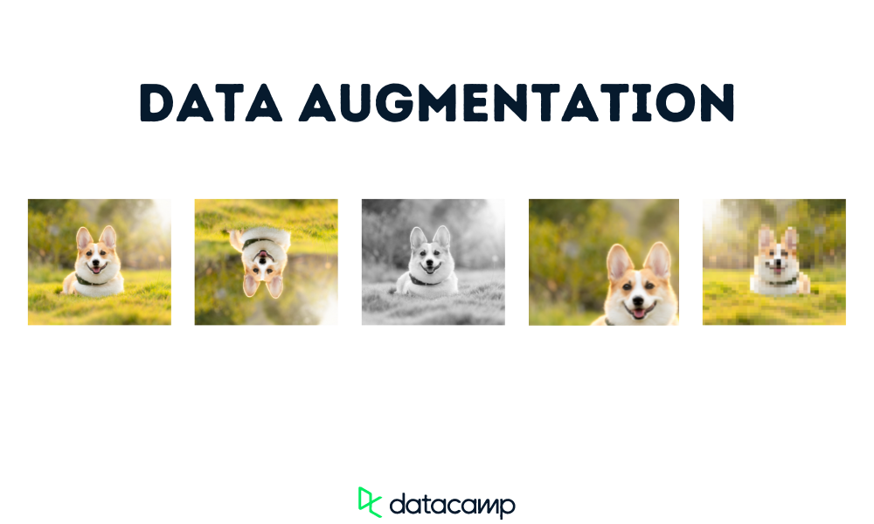
Data Augumentation
Data Augmentation: A process of artificially expanding the image dataset by applying random transformations to the original images
This helps the model learn more effectively and generalize better to new data.
For each tampered image, different types of augmentations are applied to increase variability.
The same augmentations are then consistently applied to the corresponding ground truth images.
This is done to ensure that both the tampered and ground truth images align post-augmentation.

Slide 20
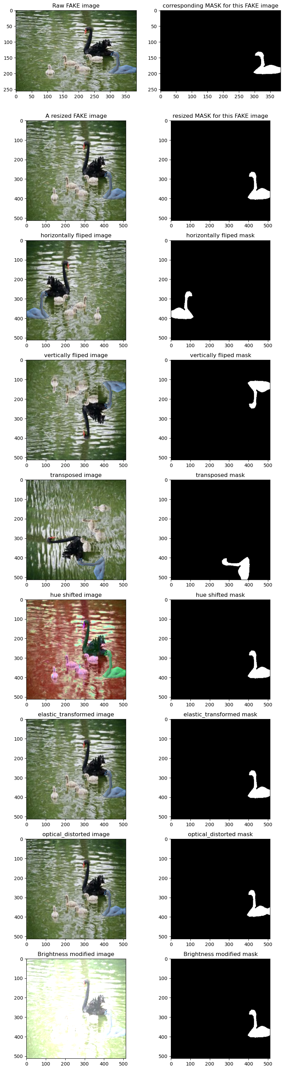
Types of Augumentation used
Vertical Flip
Resize
Transpose
Horizontal Flip

Slide 21
Optical Distortion
Hue Saturation
Elastic Transform
Random Brightness Contrast

Slide 22
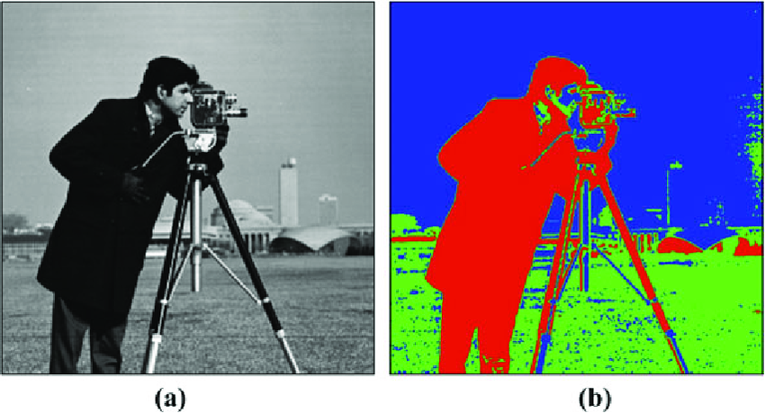
Model Used: U-NET
Purpose: U-Net is used for image segmentation, where each pixel is labeled, making it ideal for detailed tasks like image analysis.
U-Shaped Architecture: The model has an encoder (downsampling) to capture important features and a decoder (upsampling) to reconstruct the segmented image.
U-NET

Slide 23
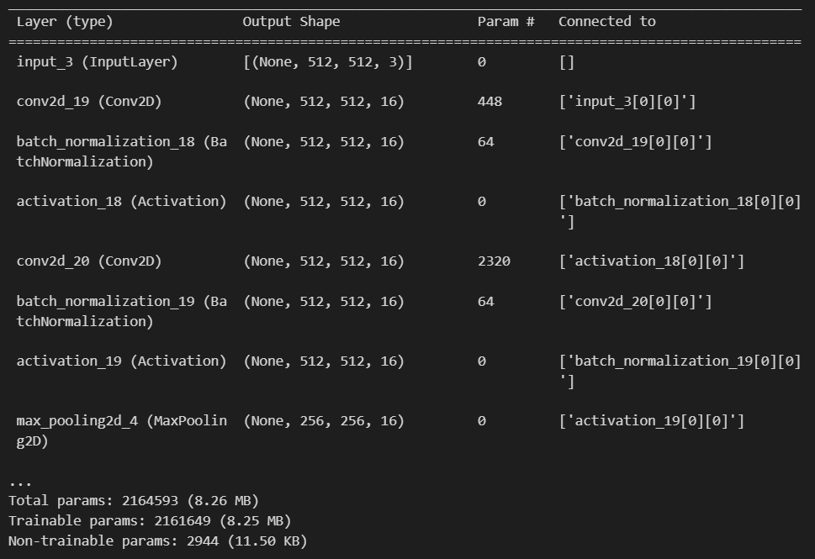
Model Summary

Slide 24
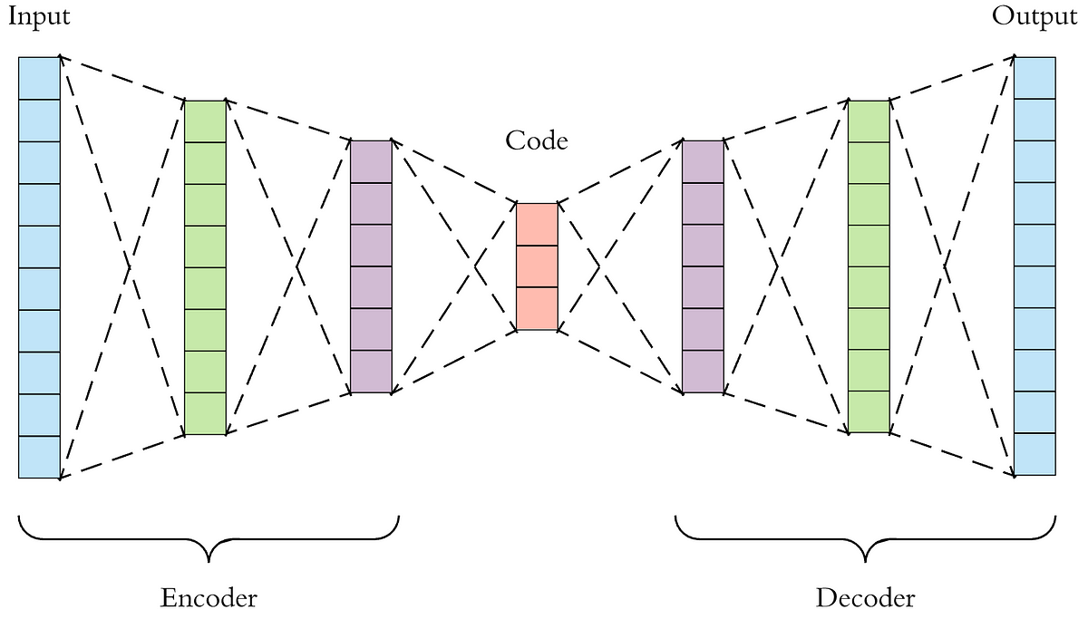
Encoder-Decoder Structure
Input Layer:Accepts images of size 512 x 512 with 3 channels (RGB).
Convolutional Layers:Stacked Conv2D layers with 16 filters in the initial layer.Each Conv2D layer extracts features with a 3x3 kernel size, helping to capture fine details.
Batch Normalization:Standardizes layer outputs to improve training stability and model convergence.
Activation Layers:ReLU Activation adds non-linearity, allowing the model to learn complex patterns.
Pooling Layer:MaxPooling downsamples the feature maps to reduce dimensionality, capturing only the most important features.
Dropout Layer:Randomly deactivates neurons during training to prevent overfitting and improve generalization.

Slide 25
Experiment 1
Training Details:Trained for 10 epochs with a batch size of 16
Early stopping triggered at epoch 4 due to no improvement in accuracy
Performance Metrics:
Inference:Model shows poor performance on augmented data with decreasing accuracy across validation and test datasets.
 | Accuracy | loss
Train Data | 72.62% | 1.065
Validation Data | 60.8% | 1.501
Test Data | 56.87% | 1.682

Slide 26
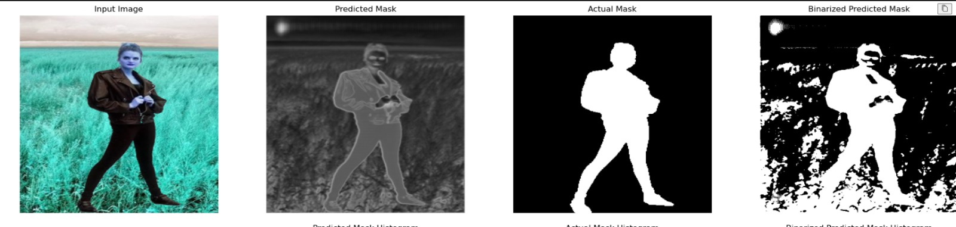
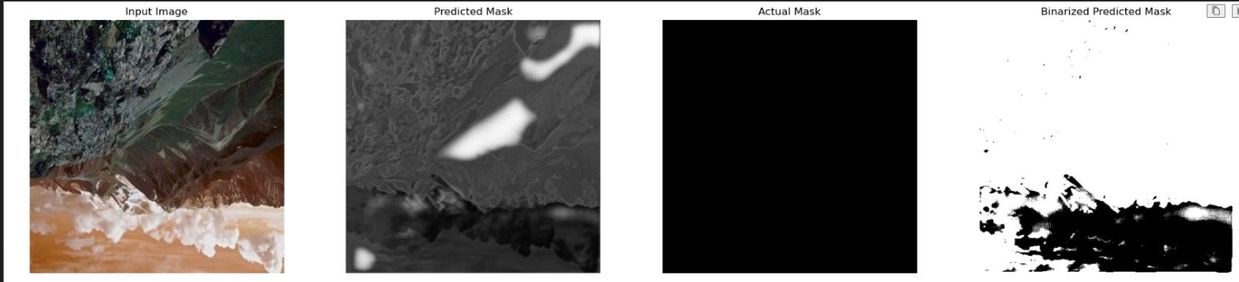
Observations

Slide 27
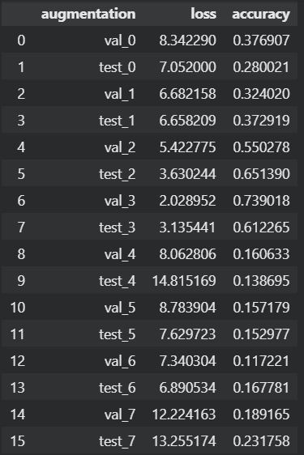
Accuracy of Each type of augmentation
S.NO | DATA AUGUMENTATION
0,1 | resize
2,3 | horizontalFlip
4,5 | verticalFlip
6,7 | transpose
8,9 | hueSaturationValue
10,11 | elasticTransform
12,13 | opticalDistortion
14,15 | randomBrightnessContrast

Slide 28
Experiment 2
Removed all the pristine images.
Trained on the same model architecture without augmented data.
Improved Performance Metrics (Overall Model):
Inference: Removing pristine images improves model performance.
Predictions :
Real: Acc : 62.77% loss = 1.914
Fake : Acc :63.47 % loss = 1.8535
 | Accuracy | loss
Train Data | 75.72% | 1.141
Validation Data | 72.84% | 1.290
Test Data | 63.4% | 1.914

Slide 29
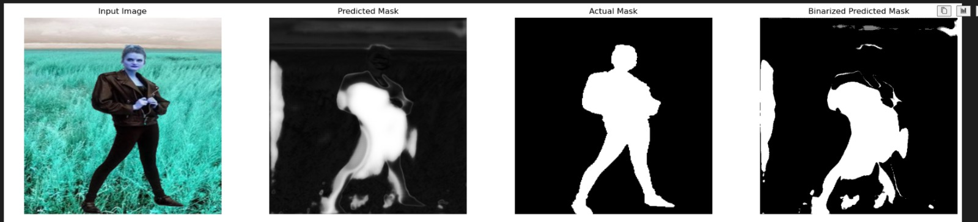
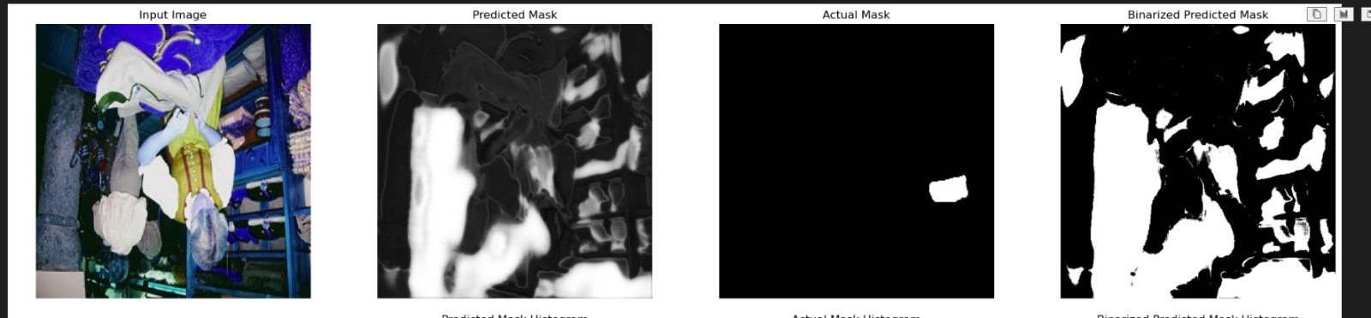
Observations

Slide 30
Performance Improvement
Trained on the same model architecture without augmented data.
Improved Performance Metrics:
Inference: Removing augmented images improves model performance.
Conclusion: Data augmentation needs refined handling to avoid adverse effects on accuracy.
Real : Acc - 88.47% loss – 0.398
Fake: Acc: 88.43% loss – 0.4182
 | Accuracy
Train Data | 86.77%
Validation Data | 84.31%
Test Data | 88.4%

Slide 31
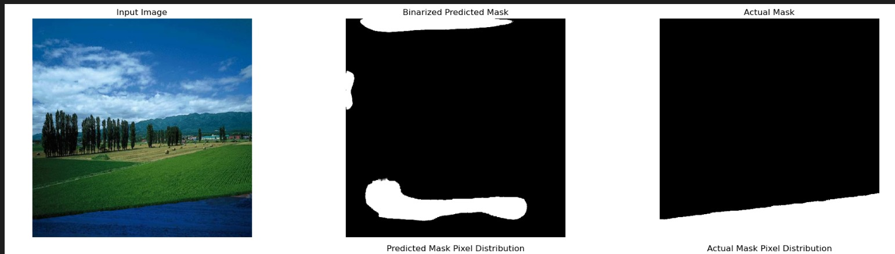
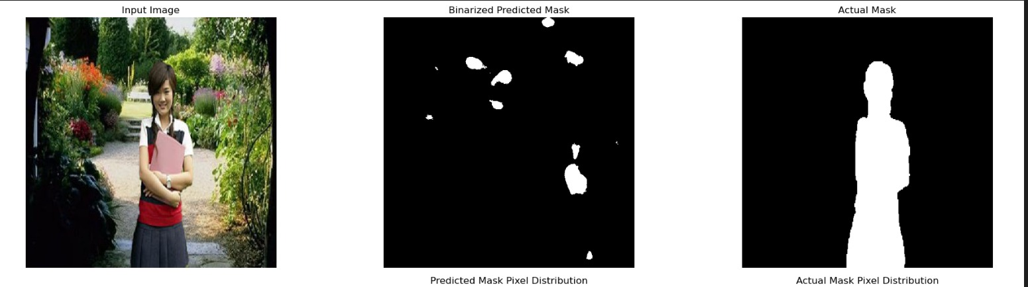
Observations

Slide 32
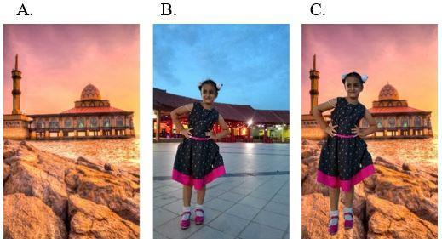
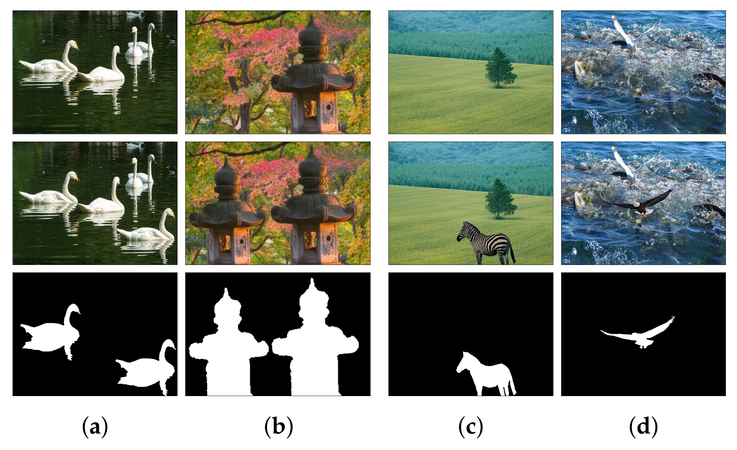

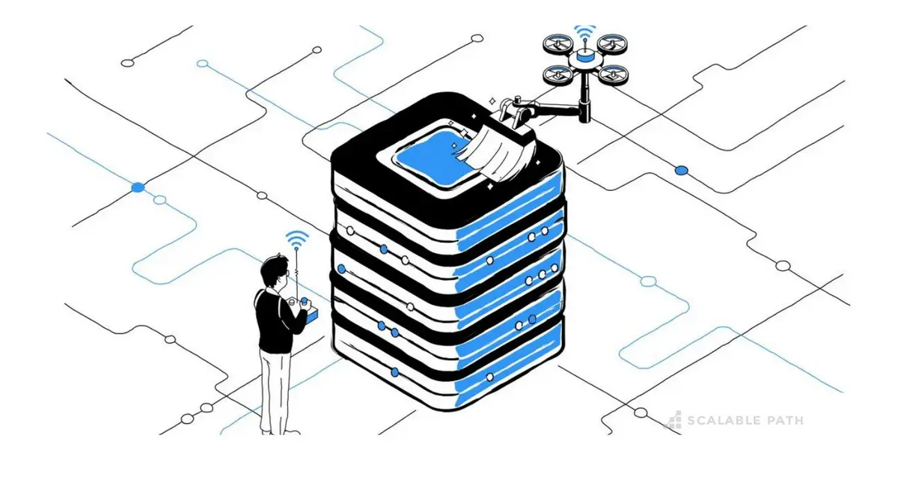
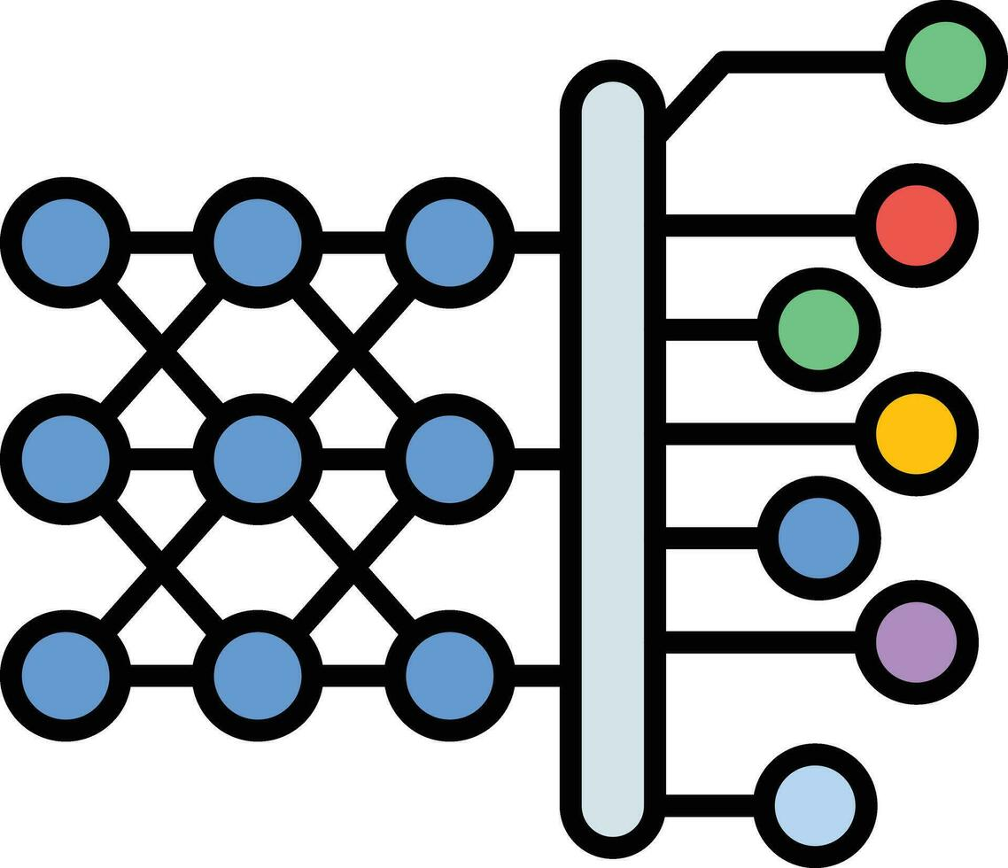

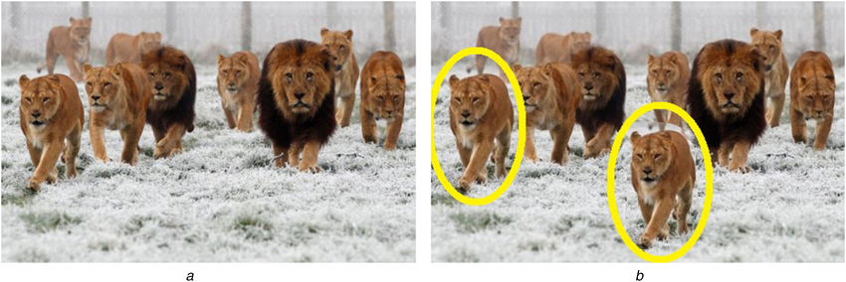
Workflow Diagram
Determining Forgery(Image Splicing)
Input data
Data preprocessing
Model Building and
Training
Try to
implement
for videos
Pixel Level
Classification
Determining Forgery(Copy-Move)
19

Slide 33
Role of each Student: 30% of Prototype Implementation
Roll No. | Name | Role
CSE21430 | Mahammad Sami Khaji | DataSet collection,retrieval and preprocessing
CSE21467 | Vinayakan VS | Data Augumentation
CSE21414 | Cheruvu Sahithee Vaibhav | Testing unet model with augmentation (with and without pristine images)
CSE21440 | Ujwal Srimanth Varma Nadimpalli | Testing unet model without augmentation and checking performance of model on each type of forgery

Slide 34
Demo of implementation
Link needs to be provided for the demo.

Slide 35
Work Plan and Publication Plan for phase 2
Including document forgery detection
Improving the current predictions .
Using more advanced deep learning architectures like transformers
Comparison between multiple transfer learning architecture

Slide 36
References

